Slide 1
Lifestyle Medicine

Slide 2
Lifestyle Medicine Specifics:
Locations:
2115 Leiter Road, Suite 300, Miamisburg
3533 Southern Blvd, Suite 3500, Kettering (Main Campus POB)
Phone Number:
Lifestyle mainline: 937-771-2060 ext 80670
Opening day:
March 30

Slide 3
Lifestyle Medicine Referrals
Referral to “Lifestyle Medicine”
Referral to “Exercise and Nutrition”
If logged into a Primary Care department, Lifestyle Medicine will display on the Pref List
Patients can also self-refer

Slide 4
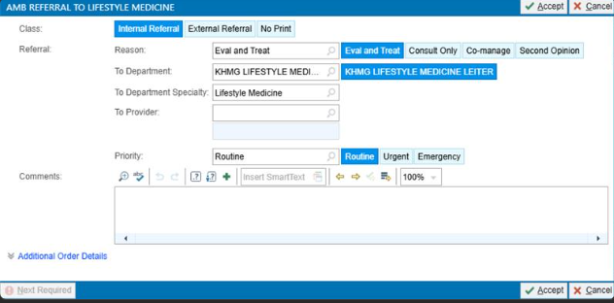
Amb Referral to Lifestyle Medicine
Steps:
Class: Internal Referral
Reason: Eval and Treat
To Dept: KHMG LIFESTYLE MEDICINE LEITER
Select Priority Level
Comments: any specific area within lifestyle medicine to support the patient
Select: Accept

Slide 5
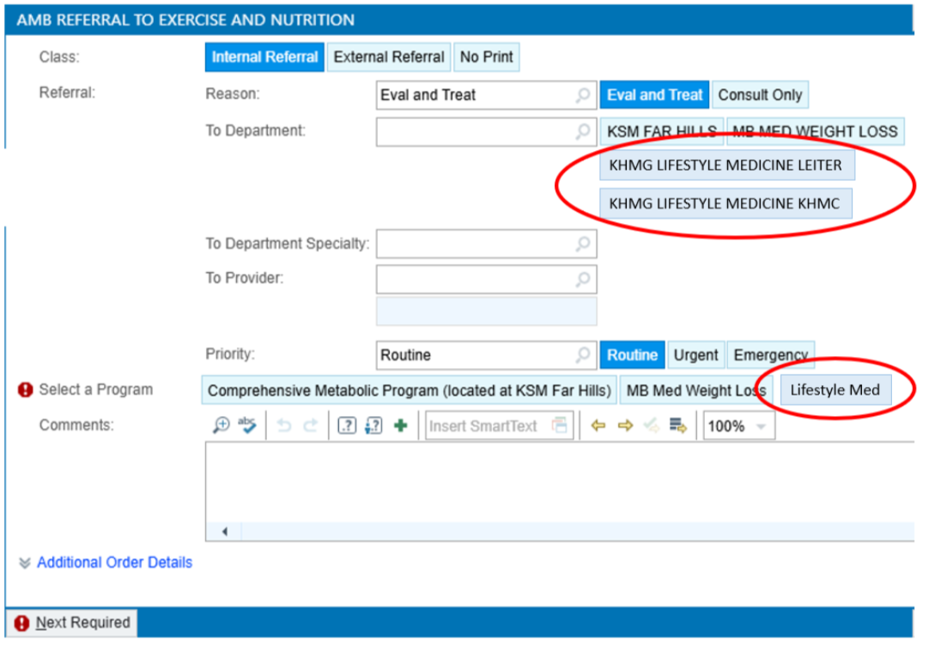
Amb Referral to Exercise and Nutrition
Steps:
Class: Internal Referral
Reason: Eval and Treat
To Dept:
KHMG LIFESTYLE MEDICINE LEITER
KHMG LIFESTYLE MEDICINE KHMC
Select Priority Level
Select a Program: Lifestyle Med
Comments: any specific area within lifestyle medicine to support the patient
Select: Accept

Slide 6
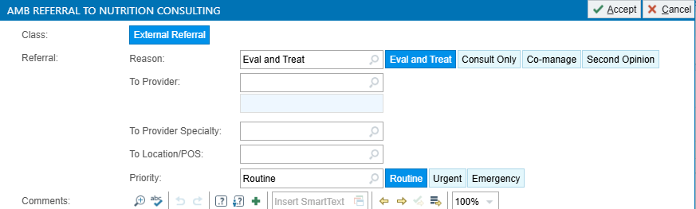
UPDATE: Amb Referral to Nutrition Consulting
Referral to Nutrition Consulting will be removed
Please use referral to:
Lifestyle Medicine
OR
Exercise and Nutrition

